Slide 1
Project Title: “Online Password Management System” Submitted By: 1. Naorem Tamphasana (Roll no. 1097) 2. Keithellakpam Oken (Roll no. 1098) 3. Wigabou Abonmei (Roll no. 1099) 4. Phanjoubam Manjit (Roll no. 1100) 5. Jackson Yanglem (Roll no. 1101) Guided by: Lairenjam Ithoi Chanu Scientist-C, Nielit Imphal

Slide 2
Abstract This project “Online Password Management System” has been developed on Python using the python framework called Django. With the use of this framework, building fast, scalable and secure websites has never been made easier and in addition, open source which is free to use and well documented! With built-in login and signup functionality and also, a option to reset password, Users can easily login, sign up and reset their password without having to worry about losing their accounts. Making sure that 2FA is implemented for better security, users need to verify their login by entering the OTP that was sent to their email that was sent to verify their login attempt. And of course, all of the data are encrypted and salted by using the python cryptography library. The secret key is only know to the developer and the admin can’t do anything about it. The user’s password and the account data that they’ve stored are easily encrypted so the admin won’t have the chance to abuse their privilege as an admin. It can be use anywhere online as long as one has an Internet connection available to them.

Slide 3
Problem of the existing system:
In the interconnected Internet world, people tend to be unaware about the way of how they manage their passwords. Password are an essential thing which gives access to a persons private or personal data. In order for a password to be unique, it must be 8+ characters long, no common words like their own names, special characters and such. They often use the same password over and over again on different platform or services, and even if they use password which are hard to crack or hacked they often write down the password or trying to remember them, which is never the convenient way of managing those password, and eventually leading them to forget the password that they used. A password manager help accomplish those weakness and helps overcome security of password by means of encryption and personal security.

Slide 4
Objective Of The Project
The main aim of this module is to make users to be to use a password manager to manager their password that is available anywhere online, on the web. User can use it on the go anywhere and anytime as long as they have an internet connected system.

Slide 5
Advantages of The Project
Brings an awareness of how important and necessity it is to store their password in a safe and secure place where no one is able to have access to it but themselves.
Users are able to use it anywhere on the go at anytime as long as they have an internet connection and a device that can use a browser.
Users can reset their password if they ever happen to forgot their password.
All of the data of the user is encrypted and stored in the database in a encrypted format. Only the user is able to see the decrypted details of their own account added.
OTP functionality is added when trying to login to ensure 2FA feature.

Slide 6
Main Modules:-
New users are able to register a account on the website easily without any difficulties
Users can login and logout anytime they want and only registered users are able to login and add their account passwords.
User can reset their password if they ever happen to lost or forget their password.
The admin cannot see the decrypted text string that is stored on the database for every account data that was added and for every user that is registered as all of the confidential data are encrypted and salted to ensure personal privacy and security.
It can used anywhere online as long as one has an internet connect and a device that is able to use a web browser.

Slide 7
Hardware Specification:
Laptop/Desktop.
AMD Ryzen 3 or higher configuration
4 GB or higher size RAM
Color Display Monitor with resolution supporting 1024X768 pixels.
USB Scroll Mouse
USB port
Keyboard
Software Specification (Server Side):
PLATEFROM : Windows 10 pro or new higher versions
TEXT EDITOR : Sublime Text 3
FRONT-END : HTML & CSS
BACK-END : Python and Django
DATABASE : sqlite3

Slide 8
Software Specification (Client Side): 1. Any Internet Connected Device 2. A web browser

Slide 9
Software Specification (Server Side): 1. Windows 10 Pro version 19041.928. 2. Python and Django installed
3. Hosting provider

Slide 10
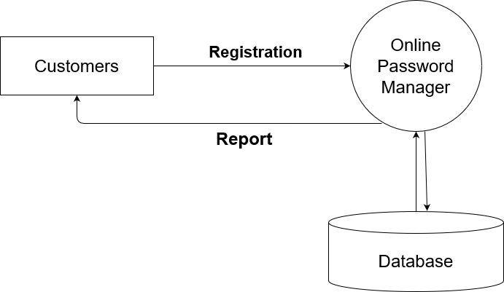
Context Diagram

Slide 11
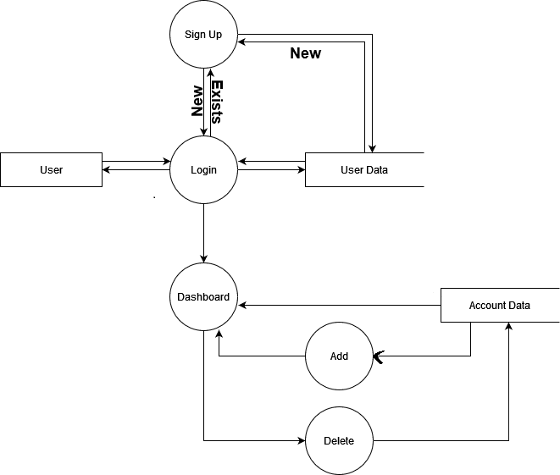
Data Flow Diagram

Slide 12
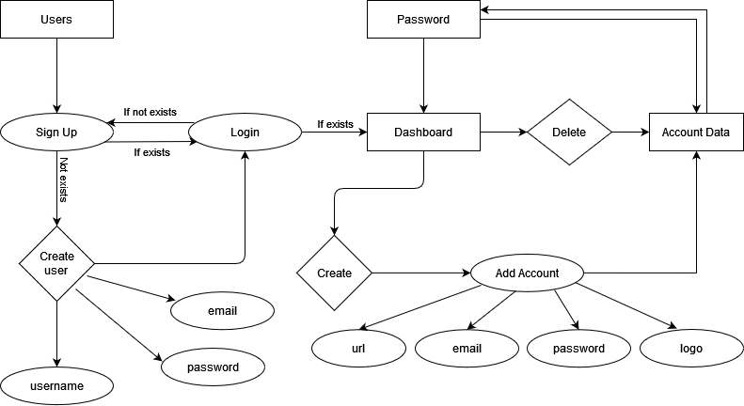
ER-Diagram

Slide 13
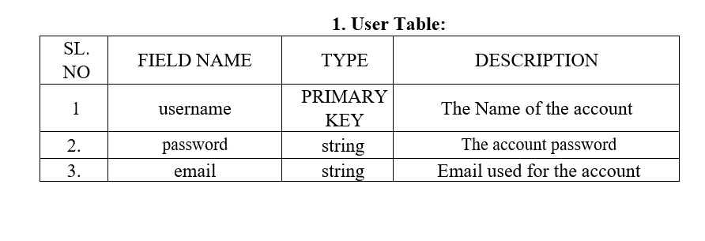
Database Design-Table Structures
Table1: User

Slide 14
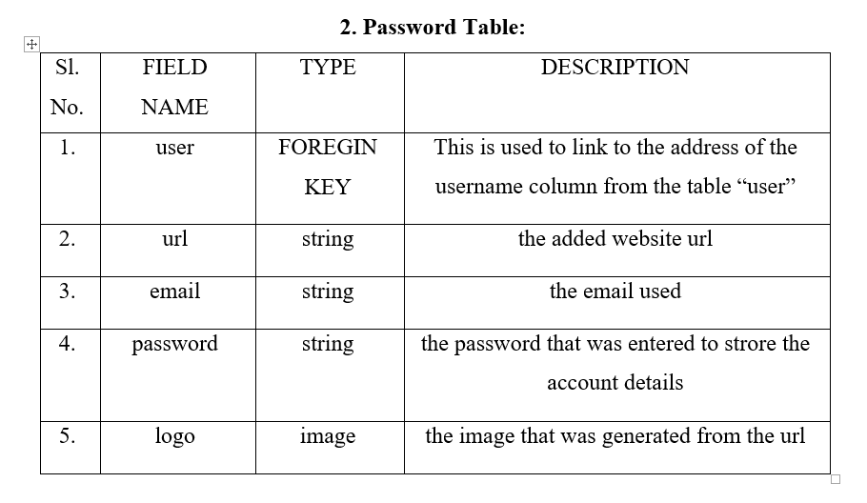
Table2: Passwords

Slide 15
Conclusion “We strongly believe that, due to its high security standard impact, research has to look and come up with the ideas of “password management system ”,for it has a function that not only provides complete authenticity, but it also provides secure, safe and avoid transparent in any fraudulent security also lot of convince than the old system of hand written records.
Implementation of this system is one of the most effective ways for people with multiple or with many accounts that need security and private in a way that helps save on way power, makes managing passwords proficient and decreases the amount of insecurities and risk.”
.

Slide 16
References 1. Websites:- https://www.google.com https://www.youtube.com https://www.github.com https://www.stackoverflow.com

Slide 17
THANK YOU

